Slide 1
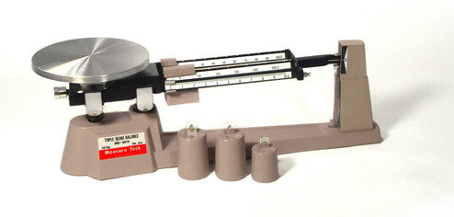
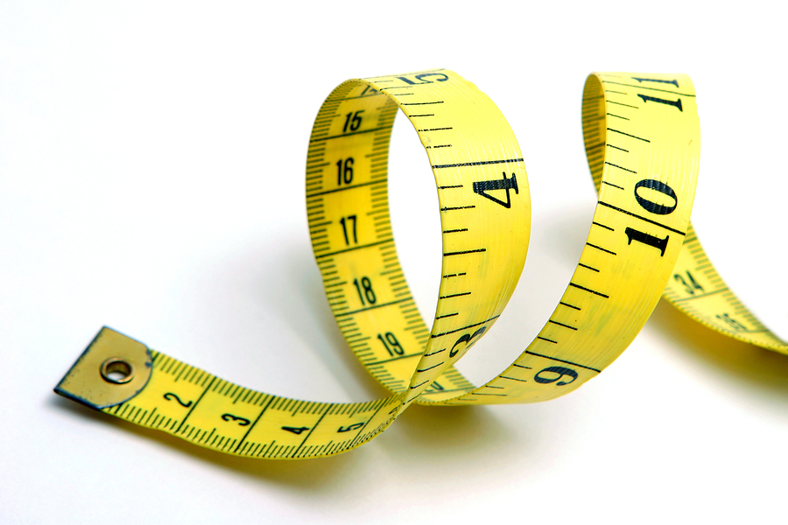
Metric Measurement

Slide 2
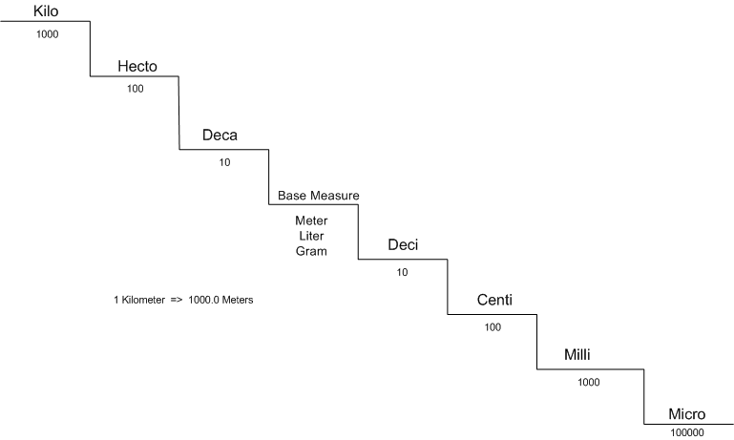
Metric System
Metric System – scientific measurement based on powers of 10.
Advantages?
International
Easy to record
Easy to convert

Slide 3
Length
LENGTH – distance between two points
Basic Unit – METER
Measured using a metric ruler

Slide 4
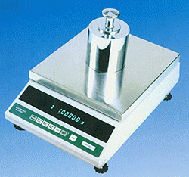
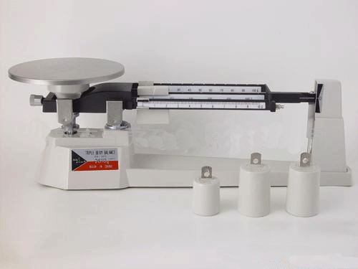
Mass
Mass is the amount of matter in an object.
Basic Unit – GRAM
Measured using a Triple-Beam Balance or an Electronic Balance.
Not to be confused with WEIGHT!!!

Slide 5
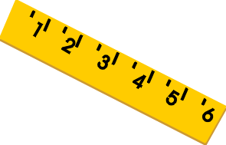
VOLUME
Volume is the amount of space an object takes up.
Basic Unit = LITER
How do we determine the Volume?
L x W x H
Graduated Cylinder

